Slide 1
HIGHRES: Highlight-based Reference-less Evaluation of Summarization
Yizhu
2021.9.22
Notes:
published by ACL 2019
it proposed a manual evaluation metric for summarization, which compare the generated summary with its source document instead of the reference summary.

Slide 2
Content
Summarization
Previous Summarization Evaluation Metrics
HIGHRES
Conclusion
Notes:
I will introduce this paper according to these 4 aspects.
First I will briefly introduce what is summarization
Then I will show you some previous summarization evaluation metric
Next I will introduce highres in detail
Finally I will give you a conclusion

Slide 3
What is Summarization?
Source document
Extractive Summary
justin timberlake and jessica biel , welcome to parenthood . the celebrity couple announced the arrival of their son , silas randall timberlake , in statements to people . `` silas was the middle name of timberlake 's maternal grandfather bill bomar , who died in 2012 , while randall is the musician 's own middle name , as well as his father 's first , '' people reports . the couple announced the pregnancy in january , …
justin timberlake and jessica biel , welcome to parenthood . the celebrity couple announced the arrival of their son .
Abstractive Summary
timberlake and biel welcome son silas randall timberlake . the couple announced the pregnancy in january .
Notes:
Summarization is to produce a shorter version of one or several long documents that express most of the meaning of the document.
It can be divided into

Slide 4
What is Summarization?
Source document
Extractive Summary
justin timberlake and jessica biel , welcome to parenthood . the celebrity couple announced the arrival of their son , silas randall timberlake , in statements to people . `` silas was the middle name of timberlake 's maternal grandfather bill bomar , who died in 2012 , while randall is the musician 's own middle name , as well as his father 's first , '' people reports . the couple announced the pregnancy in january , …
justin timberlake and jessica biel , welcome to parenthood . the celebrity couple announced the arrival of their son .
Notes:
select some important sentences from source document and make up a summary

Slide 5
What is Summarization?
Source document
Extractive Summary
justin timberlake and jessica biel , welcome to parenthood . the celebrity couple announced the arrival of their son , silas randall timberlake , in statements to people . `` silas was the middle name of timberlake 's maternal grandfather bill bomar , who died in 2012 , while randall is the musician 's own middle name , as well as his father 's first , '' people reports . the couple announced the pregnancy in january , …
justin timberlake and jessica biel , welcome to parenthood . the celebrity couple announced the arrival of their son .
Abstractive Summary
timberlake and biel welcome son silas randall timberlake . the couple announced the pregnancy in january .
Notes:
Rewrite the important contents of the source document.
The words phrased and sentences in abstractive summaries may not appear in the source document

Slide 6
Summarization Evaluation
Source Document
Summarizer
Generated Summary
Reference Summary
Evaluation
Notes:
Usually, given source document and reference summary, we can generate an abstractive summary by a summarizer
Then to evaluate the quality of the summarizer, we compare the similarity between reference summary and generated summary

Slide 7
Previous Summarization Evaluation
Automatic Evaluation Metrics
BLEU
ROUGE
Human Evaluation Metrics
Rating/Ranking scales
Best-worst scaling
Notes:
Summarization evaluation has two types
one is automatic evaluation metrics. the other is human evaluation metrics.
The typical automatic evaluation metrics are BLEU and ROUGE
Rating scaling and Best-worst scaling are widely used in human evaluation.

Slide 8
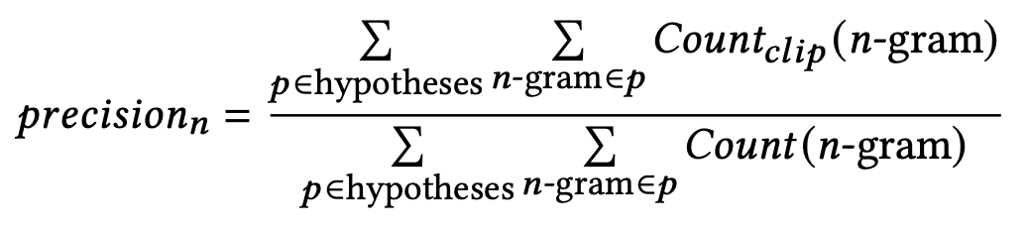
Previous Automatic Evaluation Metrics
BLEU
how much the n-grams in the generated summaries appeared in the reference summaries.
Notes:
BLEU is to calculate how much
The matched n-gram is the n-gram that appearing in both generated summary and reference summary.
BLEU is a precision score.
proportion of matched n-gram in all n-grams of generated summary.
n consecutive tokens in the sequence

Slide 9

Previous Automatic Evaluation Metrics
BLEU
how much the n-grams in the generated summaries appeared in the human reference summaries.
Generated Summary: of the
Reference Summary: It is the practical guide for the army always to heed the directions of the party .
$${precision}_{1}=1$$
$${precision}_{2}=1$$
Notes:
This is an example
the matched unigram is of and the
the matched bigram is of the
So the precision scores of unigram and bigram are 1
We can find that the higher precision scores do not denote the higher quality of generated summary.
Because of the difference between the lengths of generated summary and reference summary.
especially the length of generated summary is very short

Slide 10
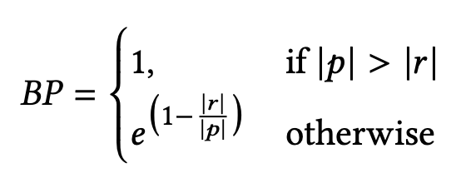
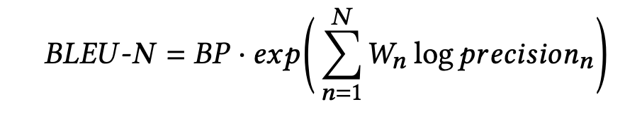

Previous Automatic Evaluation Metrics
BLEU
how much the n-grams in the generated summaries appeared in the human reference summaries.
Sentence brevity penalty
The length of generated summary
The length of reference summary
Notes:
So we will add sentence brevity penalty during computing BLEU.
p is the length,…. r is the length …
if the length of generated summary is smaller than reference summary.
The BP is smaller than 1
and the BLEU-N will be penalized by BP
This formula shows that BLEU-capital N equally considers all n-grams from unigram to capital N-gram.

Slide 11
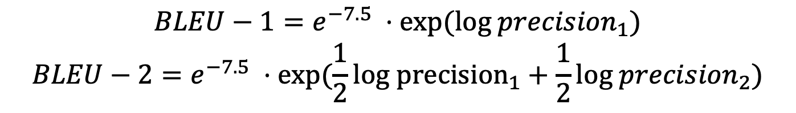
Previous Automatic Evaluation Metrics
BLEU
how much the n-grams in the generated summaries appeared in the human reference summaries.
Sentence brevity penalty
Generated Summary: of the
Reference Summary: It is the practical guide for the army always to heed the directions of the party .
$$BLEU−1=e^{−7.5} ⋅exp({log precision}_{1})$$
$$BLEU−2=e^{−7.5} ⋅exp(\frac{1}{2}{log precision}_{1}+\frac{1}{2}{log precision}_{2})$$
Notes:
This is the BLEU score of the same example
Exponential function based on natural constant e

Slide 12
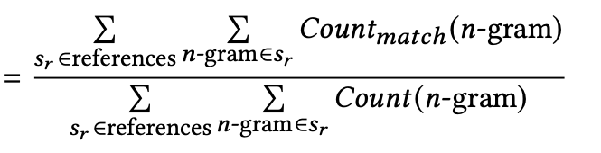

Previous Automatic Evaluation Metrics
ROUGE
how much the n-grams in the reference summaries appeared in the machine generated summaries.
$$Recall_{n}$$
Notes:
ROUGE is to calculate how much
ROUGE is a recall score.
proportion of matched n-gram in all n-grams of reference summary.

Slide 13
Previous Automatic Evaluation Metrics
ROUGE
how much the n-grams in the human reference summaries appeared in the machine generated summaries.
Generated Summary: I do not like this book .
Reference Summary: I like this book .
$${Recall}_{1}=1$$
Notes:
To calculate the recall score.
In this example, the recall between generated summary and reference summary is 1
But the meaning of these two summary are completely different.
Because the Recall ignore the advantage of long generated summaries.
The longer generated summaries are more likely to contain the tokens of reference summary.

Slide 14
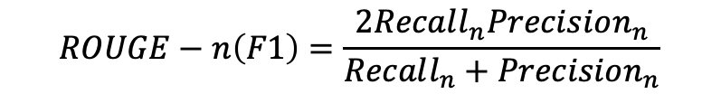
Previous Automatic Evaluation Metrics
ROUGE
how much the n-grams in the human reference summaries appeared in the machine generated summaries.
Recall, Precision, F1
$$ROUGE−n\left(F1\right)=\frac{2Recall_{n}Precision_{n}}{Recall_{n}+Precision_{n}}$$
Notes:
Thus, we usually use F1 score to denote the ROUGE scores,
which consider Recall and Precision at the same time.
The Precision score in ROUGE are the same as it in BLEU.
Different from BLEU, ROUGE-n only computes the number of matched n-gram.

Slide 15
Previous Automatic Evaluation Metrics
ROUGE
how much the n-grams in the human reference summaries appeared in the machine generated summaries.
Recall, Precision, F1
Generated Summary: I do not like this book .
Reference Summary: I like this book .
$$ROUGE−1:$$
$precision_{1}=\frac{5}{7} Recall_{1}=1 F1= \frac{2PR}{P+R}$
Notes:
This is the modified ROUGE-1 score

Slide 16
Previous Automatic Evaluation Metrics
Quiz: What's wrong with these evaluation metrics?
A source document has multiple summaries.
Summaries
Source Document
Ignore linguistic and semantic information
Notes:
One is that there can be multiple equally good summaries for the same source document
It is not fair that we only compute the similarity between source document and reference summary.
The other is that above two methods only compute the overlapping of reference summary and generated summary,
which ignore the linguistic and semantic information, such as Grammaticality and coherence

Slide 17
Previous Human Evaluation Metrics
Grammaticality
Relevance
Non-redundancy
Fluency
……
Notes:
So in summarization task, we always use human evaluation as supplement.
The human evaluation evaluates the different aspects of the generated summary according to different requirements.

Slide 18
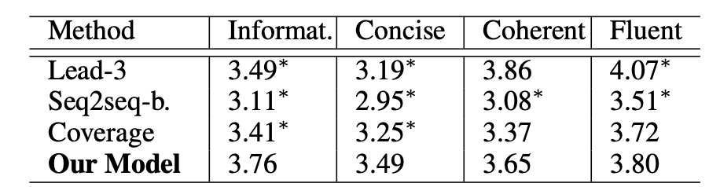
Previous Human Evaluation Metrics
Rating Scales
rate the generated summaries (from 1 to 5)
Notes:
The common human evaluation approach is rating scales.
It ask human annotators score the generated summaries from the same documents in a predefined scale for different aspect.
The score of a summary is the average score of different annotators
The evaluation result of one method is the average score of all summaries generated by this method.

Slide 19
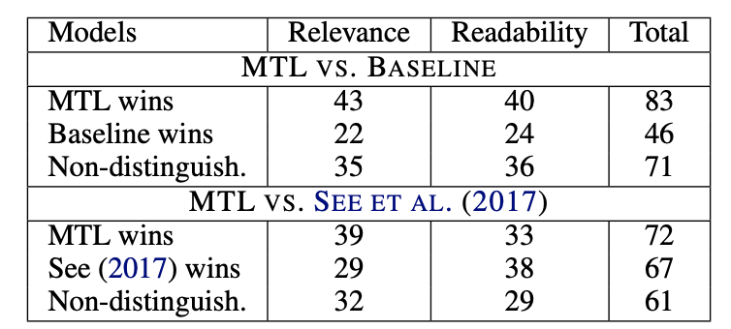
Previous Human Evaluation Metrics
Ranking Scales
rank the generated summaries
Notes:
Ranking scale is to rank the summaries generated by different models.
In this example, given summaries generated by three models, the annotators are asked to rank two generated summaries at a time.
The value in this table shows the vote of the annotators on the MTL wins, another model wins and non-distinguish.

Slide 20
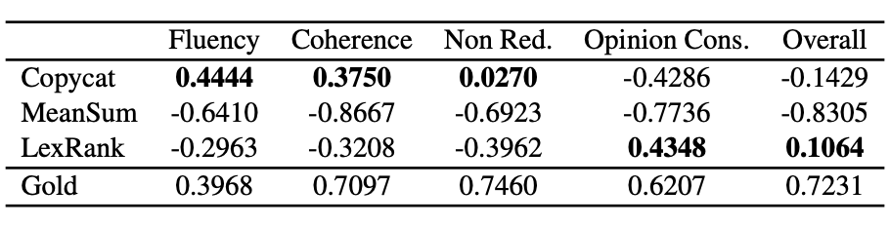
Previous Human Evaluation Metrics
Best-Worst Scaling
select the best generated summary and worst generated summary
the best frequency minus the worst frequency
Notes:
given compared summaries, the annotators are asked to select the…
Then, for the summaries generated by one model, the percentage of times a model was selected as the best minus the percentage of times it was selected as the worst.

Slide 21
Those that conduct manual assessment of the content, typically use a single reference summary, are likely to exhibit reference bias.
Notes:
Similar to automatic evaluation metrics,

Slide 22
HIGHRES
A manual evaluation
HIGHlight-based Reference-less Evaluation, in which a summary is assessed against the source document via manually highlighted salient content in the latter.
Notes:
To solve this problem, Highref is proposed
It is a manual…
The highlights are not dependent on the summaries but only on the source documents

Slide 23
HIGHRES
Three main components:
document highlight annotation
highlight-based content evaluation
clarity and fluency evaluation
Notes:
It consists of three main …

Slide 24
HIGHRES
Three main components:
document highlight annotation: can be reused
highlight-based content evaluation: “Precision” and “Recall”
clarity and fluency evaluation: independent
Notes:
the highlight annotation needs to happen only once per document, and it can be reused to evaluate many system summaries
compute the precision and recall between summary and the highlights from the first component
independent of other components and can be run in isolation.

Slide 25
HIGHRES
Three main components:
document highlight annotation: can be reused
highlight-based content evaluation: “Precision” and “Recall”
clarity and fluency evaluation: independent
Employ crowd-workers as human judges and implement appropriate sanity checking mechanisms
Notes:
As a manual evaluation metric, HIGHRes employ…
Amazon Mechanical Turk platform.

Slide 26
HIGHRES
Three main components:
document highlight annotation: can be reused
highlight-based content evaluation: “Precision” and “Recall”
clarity and fluency evaluation: independent
Employ crowd-workers as human judges and implement appropriate sanity checking mechanisms
Present an extended version of ROUGE: summary vs. document
Notes:
It also present an extended version of ROUGE taht utilizes the highlights to evaluate system summaries against the document

Slide 27
HIGHRES
document highlight annotation
ask human judges to highlight words or phrases in source document that are considered salient.
Notes:
ask human judges to read the source document and then highlight words or phrases that are considered salient.

Slide 28
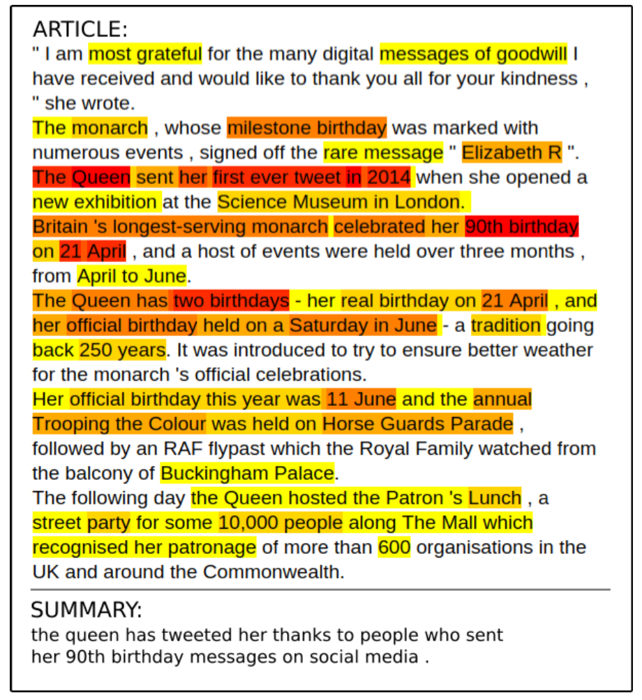
HIGHRES
document highlight annotation
ask human judges to highlight words or phrases in source document that are considered salient.
limitation: K words can be highlighted in total
Notes:
For each annotator, only K words can be highlighted in total,
K is corresponded to the length of the summary expected.
employ multiple judges per document
expect the highlighted content to have a more diverse and cover different viewpoints of the article.
The words in darker color means more annotators highlighted them as salient content.

Slide 29
HIGHRES
document highlight annotation
ask human judges to highlight words or phrases in source document that are considered salient.
limitation: K words can be highlighted in total
Notes:
The highlights are not dependent on the generated summaries or reference summaries, but only on the source documents,

Slide 30
HIGHRES
document highlight annotation
ask human judges to highlight words or phrases in source document that are considered salient.
limitation: K words can be highlighted in total
sanity check
ask the judges to answer a True/False question based on the article
Notes:
To ensure that each highlight is reliable,
we use a sanity check at the end of the task
we ask the annotators to answer a True/False question based on the article.
We rejected all annotations that failed to correctly answer the sanity check question.

Slide 31
HIGHRES
highlight-based content evaluation
present human judges a document that has been highlighted using heatmap coloring and a summary to assess.

Slide 32
HIGHRES
highlight-based content evaluation
present human judges a document that has been highlighted using heatmap coloring and a summary to assess.
assess the summary according to two aspects:
(1) All important information is present in the summary.
(2) Only important information is in the summary.
Notes:
The annotators assess the summary …
the important information is the highlighted content, which can be seen as the reference

Slide 33
HIGHRES
highlight-based content evaluation
present human judges a document that has been highlighted using heatmap coloring and a summary to assess.
assess the summary according to two aspects:
(1) how much important information is present in the summary.
(2) how much information in summary is important information.
Quiz: Which aspect is Precision? Which aspect is Recall?
Notes:
These two aspects can be explained as
The first one is the recall (content coverage) measure and the second, the precision (informativeness) measure.

Slide 34
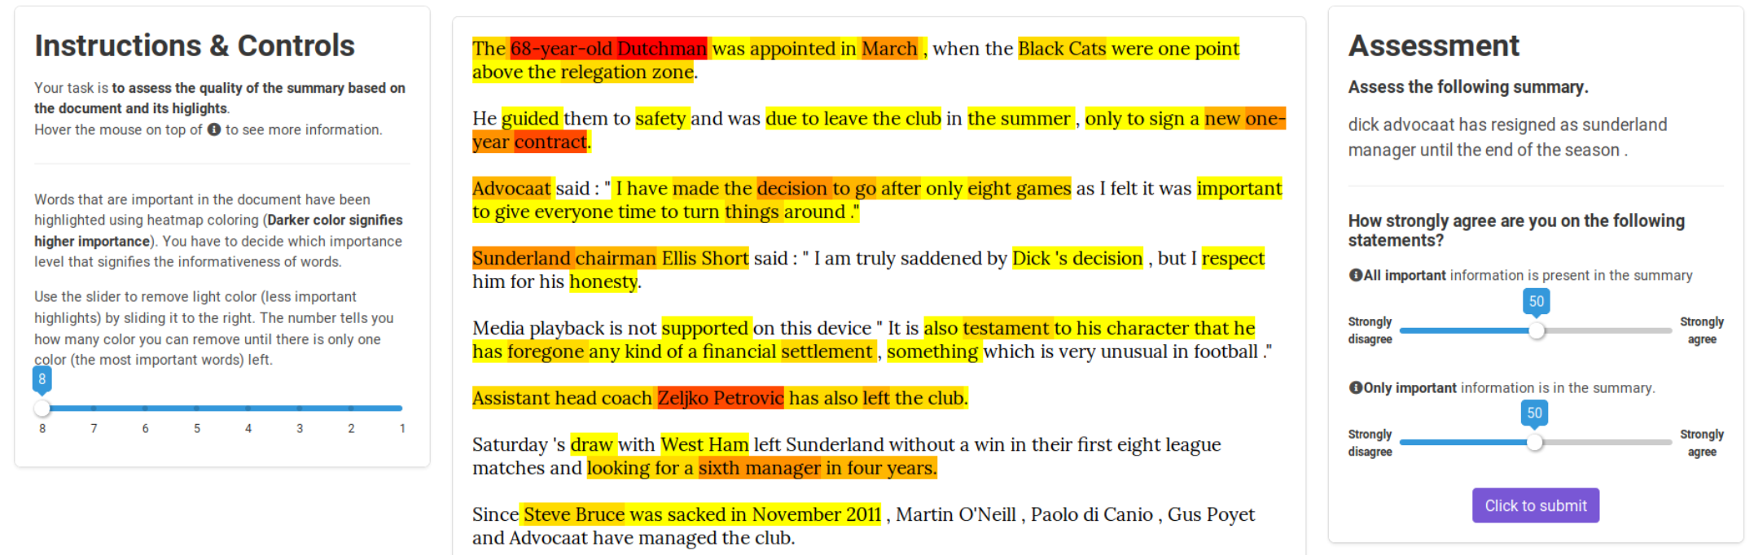
HIGHRES
highlight-based content evaluation
Notes:
This is the UI for content evaluation.
It is provided to annotators.
Judges are given an article with important words highlighted using heat map.
Judges can remove less important highlight color by sliding the scroller at the left.
At the right, judges give the recall and precision by sliding the scroller from 1 to 100 based on the given summary quality.

Slide 35
HIGHRES
clarity and fluency evaluation
For clarity,
each judge is asked whether the summary is easy to be understood
For fluency,
each judge is asked whether the summary sounds natural and has no grammatical problems.
Notes:
there should be no difficulties in identifying the referents of the noun phrases (every noun/place/event should be well-specified) or understanding the meaning of the sentence.

Slide 36
HIGHRES
clarity and fluency evaluation
For clarity,
each judge is asked whether the summary is easy to be understood
For fluency,
each judge is asked whether the summary sounds natural and has no grammatical problems.
Evaluate each metric separately.
Notes:
poor fluency can affect clarity, but a summary can have perfect fluency but low clarity
To ensure that the judgments for clarity and fluency are not affected by each other we evaluate each

Slide 37
HIGHRES
clarity and fluency evaluation
For clarity,
each judge is asked whether the summary is easy to be understood
For fluency,
each judge is asked whether the summary sounds natural and has no grammatical problems.
Evaluate each metric separately.
Sanity checking
insert three artificial summaries of different quality (good, mediocre and bad summaries)
reject judgements that failed to pass this criteria: bad < mediocre < good.
Notes:
The good summary is the unedited one, while the others are generated from sentences randomly sampled from the source document.
For the mediocre summary, some words are edited to introduce some grammatical or syntactic errors
for the bad summary, the words are further scrambled.
We reject judgements that failed to pass this criteria: bad < mediocre < good.

Slide 38
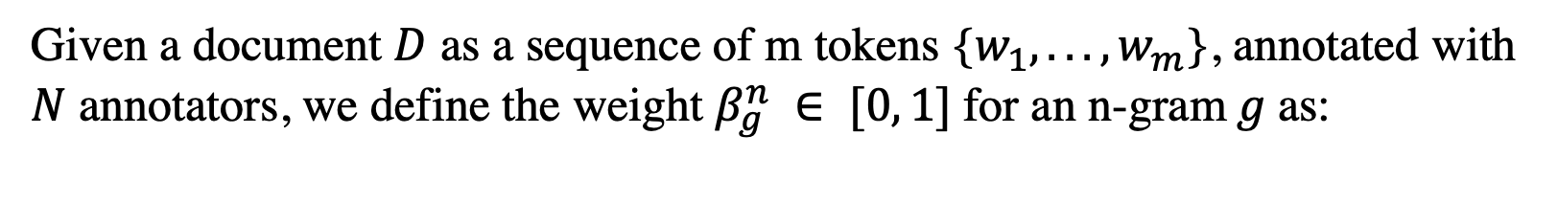

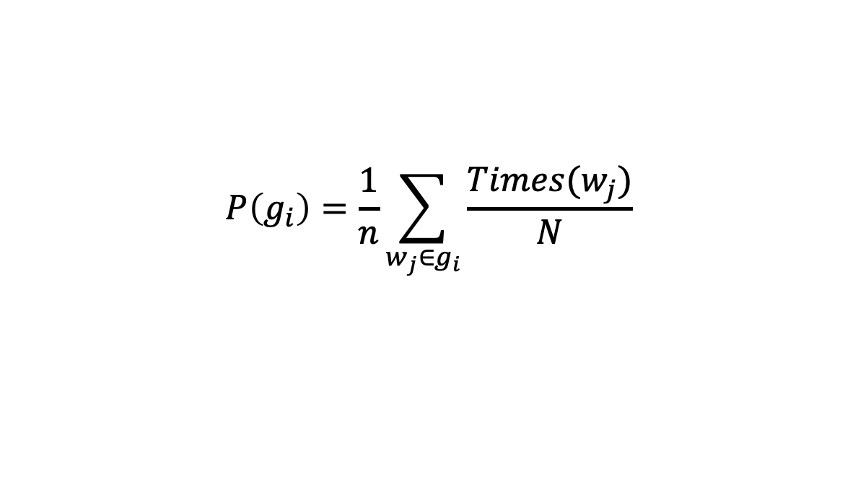
HIGHRES
Highlight-based ROUGE Evaluation
Given a document $D$ as a sequence of m tokens {$w_{1}, . . . , w_{m}$}, annotated with $N$ annotators, we define the weight $β_{g}^{n} ∈ [0, 1]$for an n-gram$g$as:
$$P\left(g_{i}\right)=\frac{1}{n}\sum_{w_{j}∈g_{i}}{\frac{Times(w_{j})}{N}}$$
The probability of $w_{j}$ being highlighted
Notes:
g_i meas the n-gram g may occur more than once in document

Slide 39

HIGHRES
Highlight-based ROUGE Evaluation
Given a document $D$ as a sequence of m tokens {$w_{1}, . . . , w_{m}$}, annotated with $N$ annotators, we define the weight $β_{g}^{n} ∈ [0, 1]$for an n-gram$g$as:
$$P\left(g_{i}\right)=\frac{1}{n}\sum_{w_{j}∈g_{i}}{\frac{Times(w_{j})}{N}}$$
The probability of $w_{j}$ being highlighted
The probability of $g_{i}$ being highlighted

Slide 40

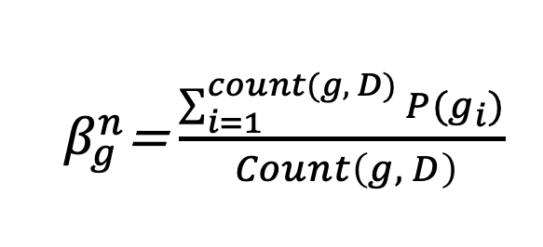
HIGHRES
Highlight-based ROUGE Evaluation
Given a document $D$ as a sequence of m tokens {$w_{1}, . . . , w_{m}$}, annotated with $N$ annotators, we define the weight $β_{g}^{n} ∈ [0, 1]$for an n-gram$g$as:
${ β}_{g}^{n}$=$\frac{\sum_{i=1}^{count(g, D)}{P(g_{i})}}{ Count\left(g, D\right)}$
The number of $g$ in $D$
if an n-gram is highlighted by every crowd-worker, the n-gram $g$ will have a maximum weight of${ β}_{g}^{n}=1$.
Notes:
the sum of probability of all g being highlighted in source document
divided by the number of these g

Slide 41
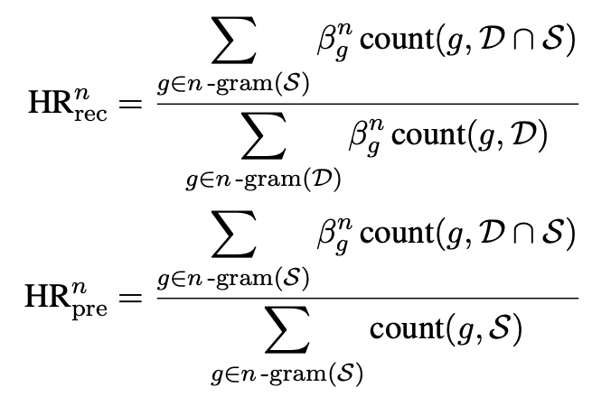
HIGHRES
Highlight-based ROUGE Evaluation
Given a document $D$ as a sequence of m tokens {$w_{1}, . . . , w_{m}$}, annotated with $N$ annotators, we define the weight $β_{g}^{n} ∈ [0, 1]$for an n-gram$g$as:
${ β}_{g}^{n}$=$\frac{\sum_{i=1}^{count(g, D)}{P(g_{i})}}{ Count\left(g, D\right)}$

Slide 42
HIGHRES—Experiment
Data
XSUM
Model
TConvS2S
PtGen
Highligth Annotation
10 different participants for each of 50 articles.
Notes:
XSUM is the popular abstractive summarization dataset with short summary.

Slide 43
HIGHRES—Experiment
Highlight Annotation
The participants were free to highlight content as they deem fit.
Compute agreement on the binary labels provided by each judge on each word (highlighted or not)
an average agreement of 0.19 for the 50 articles considered.
Notes:
The low agreement score does not indicate a poor annotation process necessarily

Slide 44
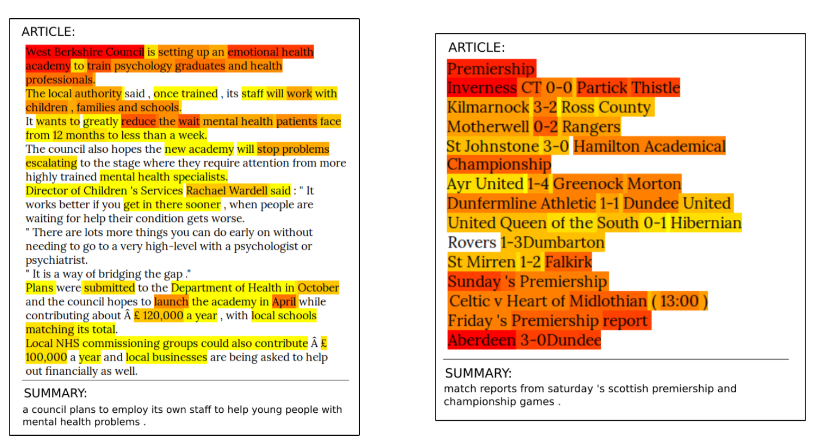
HIGHRES—Experiment
Notes:
left has higher agreement, right is lower
when the annotator agreement is high, the article appears to be more informative;
when the agreement is low, it does not contain any informative con-tent from the article but only to inform the reader about the article’s topic and scope.

Slide 45
HIGHRES—Experiment
Highlight Annotation
The participants were free to highlight content as they deem fit.
Compute agreement on the binary labels provided by each judge on each word (highlighted or not)
an average agreement of 0.19 for the 50 articles considered.
The annotators have different opinions on which parts of an article are salient.
These results confirm that the annotation behaviour originates from the nature of the document and the summary it requires, and validates our highlight annotation setup.

Slide 46
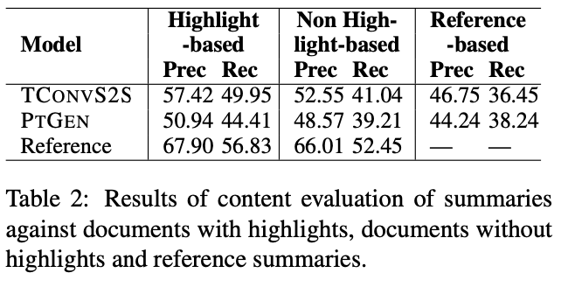
HIGHRES—Experiment
Content Evaluation of Summaries
Difference between two models:
Highlight>non-highlight>reference
Notes:
We assessed the summaries against (i) documents with highlights (ii) original documents without highlights and (iii) reference summaries
reference-human annotated are best
the performance difference in TCONVS2S and PTGEN is greatly amplified when they are evaluated against document with highlights
The hightlight is effective on comparing different models.

Slide 47
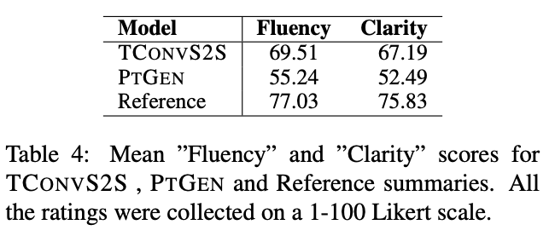
HIGHRES—Experiment
Clarity and Fluency Evaluation
Notes:
consistent with highlight-based content evaluation,
which shows that the evaluation results of human annotator are reliable.

Slide 48
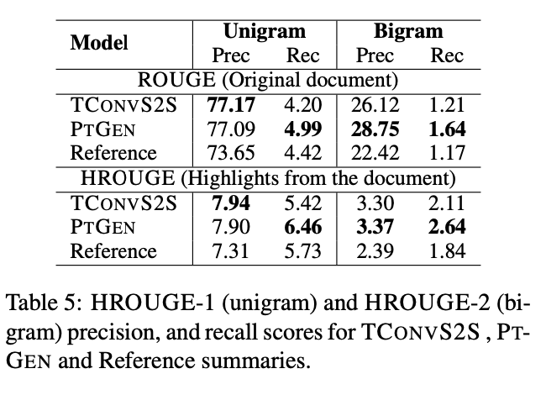
HIGHRES—Experiment
Highlight-based ROUGE Evaluation
Compare summaries with highlighted text
Notes:
The higher score in this table cannot reflect the effectiveness of the model
as the reference summaries always get the worst scores.
Precision scores of HROUGE is the number of highlighted tokens in generated summaries divided by the length of generated summaries.
the number of highlighted tokens is much smaller than the normal tokens appearing in both generated summaries and reference summaries.
Recall scores are very low in all cases, since the 10 highlights obtained per document or the documents themselves, taken together, are much longer than any of the summaries.

Slide 49
HIGHRES—Experiment
Compare summaries with highlighted text
Content evaluation
Fluency and Clarity
HROUGE
Notes:
TCONVS2S is better than PTGEN for recognizing pertinent content and generating informative summaries due to its ability to represent high-level document knowledge in terms of topics and long-range dependencies
Both ROUGE and HROUGE favour method of copying content from the original document and penalizes abstractive methods, thus it is not sur- prising that PTGEN is superior to TCONVS2S, as the former has an explicit copy mechanism.

Slide 50
Conclusion
Previous automatic summarization evaluation metrics considered one single reference summary during evaluation.
Previous manual evaluation metrics also use one single reference summary for evaluation.
HIGHRES manually highlighted words/phrases/sentences in source document.
Reduce labor costs?Automatic evaluation?
Notes:
automatic measures are unlikely to be sufficient to measure performance in summarization due to considering a single reference summary
Obtaining multiple ones increases dataset creation cost
Thus evaluation against them is likely to exhibit reference bias

Slide 51
Previous Automatic Evaluation Metrics
METEOR
unigram
Notes:
Compare

Slide 52
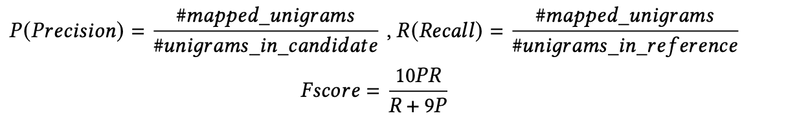
Previous Automatic Evaluation Metrics
METEOR
unigram: in a given alignment, a single unigram in one string cannot map to more than one unigram in the other string.
Notes:
Compare

Slide 53
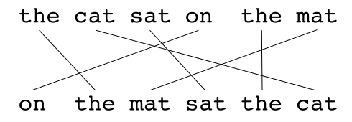
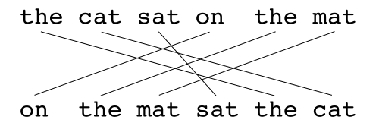
Previous Automatic Evaluation Metrics
METEOR
unigram: in a given alignment, a single unigram in one string cannot map to more than one unigram in the other string.
Generated Summary
Reference Summary
✔️
Notes:
If there are two alignments with the same number of mappings, the alignment is chosen with the fewest crosses, that is, with fewer intersections of two mappings. From the two alignments shown, alignment (a) would be selected at this point. Stages are run consecutively and each stage only adds to the alignment those unigrams which have not been matched in previous stages. Once the final alignment is computed, the score is computed as follows: Unigram precision P is calculated as:

Slide 54
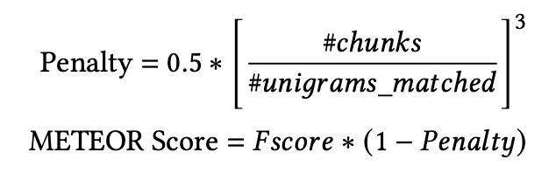
Previous Automatic Evaluation Metrics
METEOR
unigram: in a given alignment, a single unigram in one string cannot map to more than one unigram in the other string.
fragmentation penalty
Notes:
Compare

Slide 55
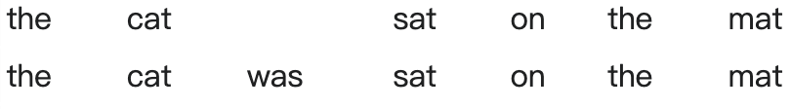

Previous Automatic Evaluation Metrics
METEOR
unigram: in a given alignment, a single unigram in one string cannot map to more than one unigram in the other string.
fragmentation penalty
Generated Summary
Reference Summary
$$\#chunk=2$$
Notes:
In order to compute this penalty, unigrams are grouped into the fewest possible chunks, where a chunk is defined as a set of unigrams that are adjacent in the hypothesis and in the reference. The longer the adjacent mappings between the candidate and the reference, the fewer chunks there are. A translation that is identical to the reference will give just one chunk. The penalty p is computed as follows,

Slide 56
Previous Automatic Evaluation Metrics
METEOR
unigram: in a given alignment, a single unigram in one string cannot map to more than one unigram in the other string.
fragmentation penalty
unigrams can be matched based on their surface forms, stemmed forms, and meanings
Notes:
In order to compute this penalty, unigrams are grouped into the fewest possible chunks, where a chunk is defined as a set of unigrams that are adjacent in the hypothesis and in the reference. The longer the adjacent mappings between the candidate and the reference, the fewer chunks there are. A translation that is identical to the reference will give just one chunk. The penalty p is computed as follows,

Slide 57

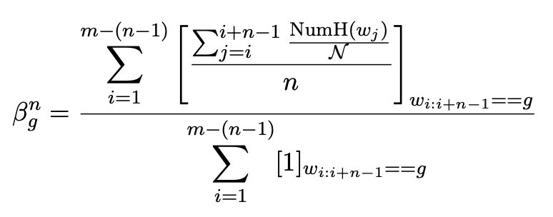
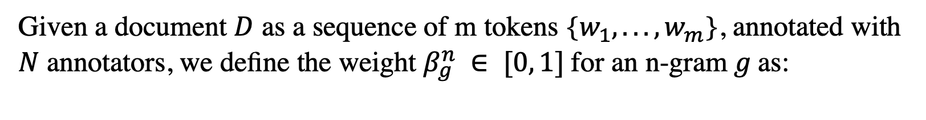
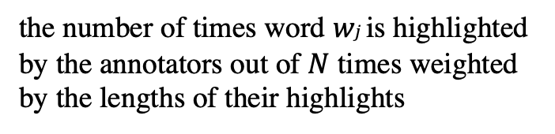
HIGHRES
Highlight-based ROUGE Evaluation
Given a document $D$ as a sequence of m tokens {$w_{1}, . . . , w_{m}$}, annotated with $N$ annotators, we define the weight $β_{g}^{n} ∈ [0, 1]$for an n-gram$g$as:
the number of times word $wj$ is highlighted by the annotators out of $N$ times weighted by the lengths of their highlights
$[x]y$is an indicator function which returns x if y is true and 0, otherwise.
if an n-gram is highlighted by every crowd-worker and the length of the highlight of each crowd-worker is$K$, the n-gram $g$ will have a maximum weight of${ β}_{g}^{n}=1$.
Notes:
The good summary is the unedited one, while the others are generated from sentences randomly sampled from the source document. For the mediocre summary, some words are edited to introduce some grammatical or syntactic errors while for the bad summary, the words are further scrambled.
We reject judgements that failed to pass this criteria: bad < mediocre < good.

Slide 58

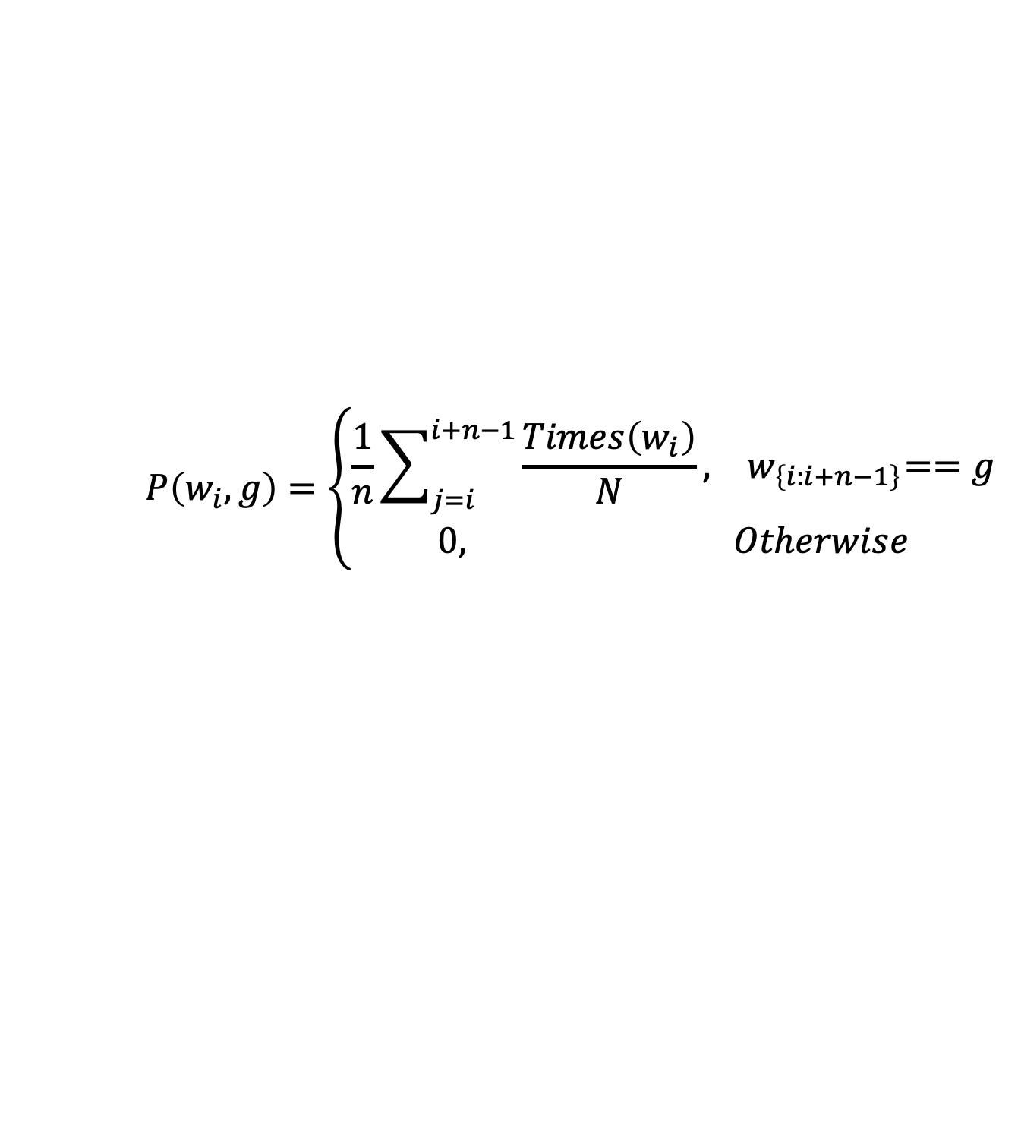
HIGHRES
Highlight-based ROUGE Evaluation
Given a document $D$ as a sequence of m tokens {$w_{1}, . . . , w_{m}$}, annotated with $N$ annotators, we define the weight $β_{g}^{n} ∈ [0, 1]$for an n-gram$g$as:
$$P\left(w_{i},g\right)=\left\{\begin{aligned}\frac{1}{n}\sum_{j=i}^{i+n−1}{\frac{Times\left(w_{i}\right)}{N}, { w}_{\left\{i:i+n−1\right\}}==g} \\ 0, Otherwise\end{aligned}\right.$$
The Probability of $w_{i}$ being highlighted
Notes:
The good summary is the unedited one, while the others are generated from sentences randomly sampled from the source document. For the mediocre summary, some words are edited to introduce some grammatical or syntactic errors while for the bad summary, the words are further scrambled.
We reject judgements that failed to pass this criteria: bad < mediocre < good.

Slide 59
HIGHRES
Highlight-based ROUGE Evaluation
Given a document $D$ as a sequence of m tokens {$w_{1}, . . . , w_{m}$}, annotated with $N$ annotators, we define the weight $β_{g}^{n} ∈ [0, 1]$for an n-gram$g$as:
$$P\left(w_{i},g\right)=\left\{\begin{aligned}\frac{1}{n}\sum_{j=i}^{i+n−1}{\frac{Times\left(w_{i}\right)}{N}, { w}_{\left\{i:i+n−1\right\}}==g} \\ 0, Otherwise\end{aligned}\right.$$
The Probability of $w_{i}$ being highlighted
Considering the times
Notes:
The good summary is the unedited one, while the others are generated from sentences randomly sampled from the source document. For the mediocre summary, some words are edited to introduce some grammatical or syntactic errors while for the bad summary, the words are further scrambled.
We reject judgements that failed to pass this criteria: bad < mediocre < good.

Slide 60
However, manual evaluation of the system generated summaries is inconsistent due to the difficulty the task poses to human non-expert readers.
Notes:
To ensure that each highlight is reliable, we performed a sanity check at the end of the task where we ask the judges to answer a True/False question based on the article. We rejected all annotations that failed to correctly answer the sanity check question.

Slide 61
Summarization Evaluation
A source document has multiple summaries.
Summaries
Source Document
Notes:
different aspects

